Slide 1
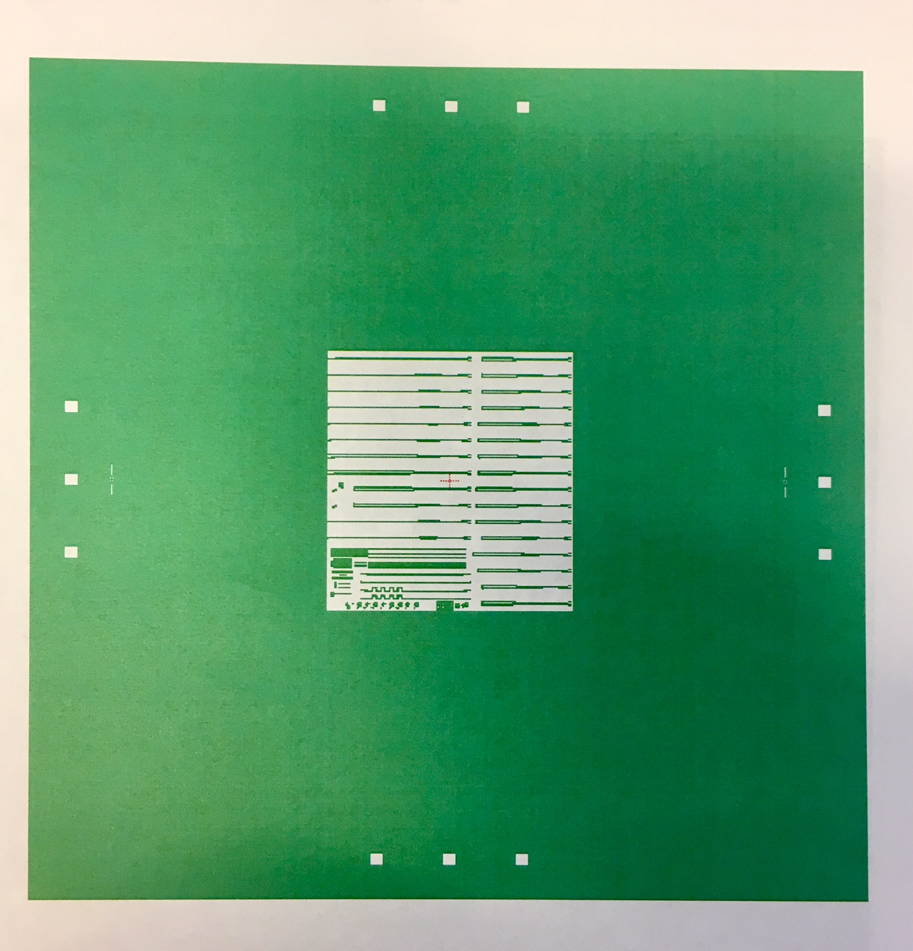
Mask Layouts
Single Layer Mask
( single field centered within the plate)

Slide 2
Mask Layouts
Single Layer Mask
( single field centered within the plate)

Slide 3
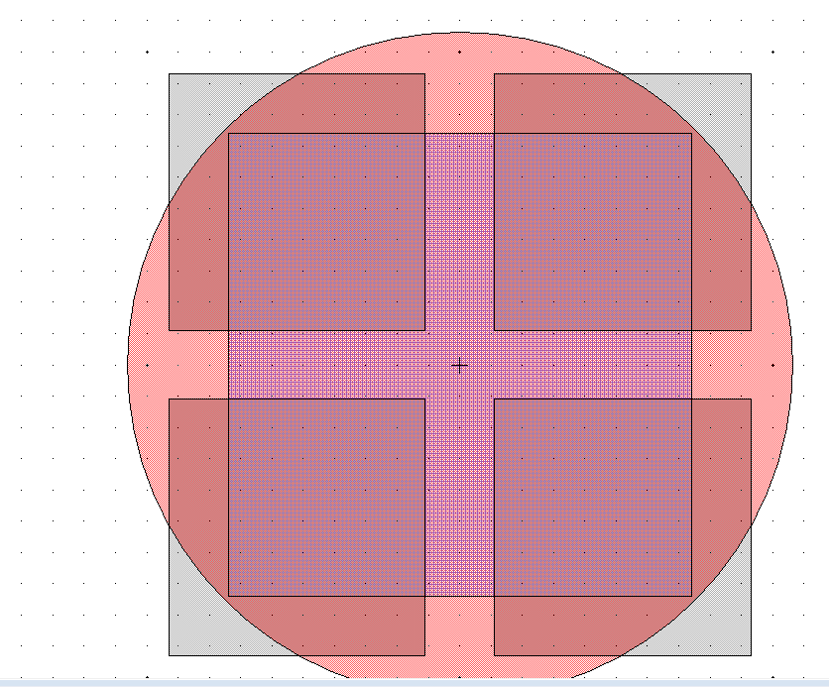
Exposure Field (red circle) D=100mm
Large Square (blue box),
max die size (74x74) mm2
This part of your mask will not be properly exposed
The blue box in the middle is the largest single square size (die size ~(14.8x14.8)mm2 that you can shoot on the wafer. This is because the “spot” size on the wafer is~20 mm, mask scale is 5x (100mm). Anything outside the red circle is not going to be exposed properly. There will be some bleed through but the features will be under expose.
Mask plate (5x5)” ~ (127x127)mm2

Slide 4
Quarter with BL orientation writing the program TESTQ
AUTOSTEP200: LOG IN [10,1]
CHUCK:142 (for ¼ of 2” pieces or smaller substrates then 2” )
Diameter= 55mm ( if 1/4 of 2 inch)
Cell size (die size):
X=7.5750mm, Y=8.0000mm
Gap between die=0.5mm
Step size (step from die to die):
X=8.0750mm, Y=8.5000mm
Distance from DIE center to the lower left corner:
X/2=3.7875mm
Y/2=4.0000mm
Adding 1 mm from the corner in X, and Y direction bring coordinates for x,y:
X=3.7875+1.0=4.7875mm
Y=4.0000+1.0=5.0000mm
This is the pass shift for BL orientation:
PASS SHIFT: x=+4.7875, y=-5.0000

Slide 5
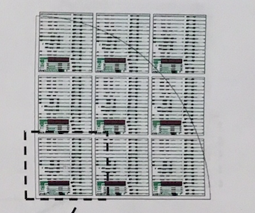
First layer (Layer#1 or your first lithography)
Running the job: EX TESTQ, pass: 1
BL: Left objective (R3, C1), Right objective (R3, C3),
Press “A” on the key board, the stage moves, and left objective should be positioned above R3C1
Find the lower left corner of your substrate
Press “D”(to switch movement from die to die)
Aligning takes time (align well along x- axis, and y-axis)!
The left objective should be positioned above R3C1 prior exposing
Key offset is : x=0, y=0; PASS SHIFT: x=+4.7875, y=-5.0000
R1C1
R3C1
R3C3

Slide 6
How to expose first layer (aligning to the LL(lower left)corner of sample)
How to align
Orientation A - BL
Find the proper chuck, load the sample on the chuck, use screws to help in positioning the sample always at the same place (turn ON the vacuum)
Load chuck on the stage (turn ON the vacuum)
Press “A” on the keyboard to move the stage , so LEFT objective is above die R3C1
Find the BL corner
Press button “D” on the key board, and press on arrow ➔ to step from die to die. Be careful, step as many times as the number of dies you have in that direction ( if you have 3 columns, you can step 3X) . Be slow and meticulous. Stay on the sample.
If you step out of sample you might receive the message “ Q” for quit. Press “red” button inside of the chamber and start all over with the aligning
Once aligning is complete (always use right window on monitor for aligning), go back to die R3C1 , so LEFT objective is above die R3C1, press expose
Watch the numbers on voltmeter (column height). This should be in range of -10V to 10V. Ideal focus would be around 0V.
If 0.5mm is added along the edges (x,y). In my calculation I added 1mm along the edges!

Slide 7
Quarter with BR orientation writing the program TESTQ
AUTOSTEP200: LOG IN [10,1]
CHUCK:142 (for ¼ of 2” pieces) or smaller then 2”)
Diameter= 55mm ( if 1/4 of 2 inch)
Cell size (die size):
X=7.5750mm, Y=8.0000mm
Gap between die=0.5mm
Step size ( step from die to die):
X=8.0750mm, Y=8.5000mm
Distance from DIE center to the lower left corner:
X/2=3.7875mm
Y/2=4.0000mm
Adding 1 mm from the corner in X, and Y direction bring coordinates for x,y:
X=3.7875+1.0=4.7875mm
Y=4.0000+1.0=5.0000mm
This is the pass shift for BL orientation:
PASS SHIFT: x=-4.7875, y=-5.0000

Slide 8
First layer (Layer#1 or your first lithography)
Running the job: EX TESTQ, pass: 2
BR orientation: L objective (R3,C1), R objective (R3,C3)
Do Not use “A” for this orientation!
Find the lower right corner
Press “D”(to switch movement from die to die)
Aligning takes time (align well along x- axis, and y-axis)!
The right objective should be positioned above R3C3 prior exposing
Key offset is : x=0, y=0; PASS SHIFT: x=-4.7875, y=-5.0000
R1C1
R3C1
R3C3

Slide 9
How to expose first layer (aligning to the LR(lower right)corner of sample))
How to align
Orientation B - BR
Find the proper chuck, load the sample on the chuck, use screws to help in positioning the sample always at the same place (turn ON the vacuum)
Load chuck on the stage ( turn ON the vacuum)
Find the BR corner
Press button “D” on the key board, and press on arrow ➔ to step from die to die. Be careful, step as many times as the number of dies you have in that direction. Be slow and meticulous. Stay on the sample.
If you step out of the sample you might receive the message “Q” and option to quit. Press “red” button inside of the chamber (lower, left side) and you have to start all over with aligning
Once aligning is complete (always use right window on monitor for aligning), make sure your RIGHT objective is above die R3C3, press expose
Watch the numbers on voltmeter (column height). This should be in range of -10V to 10V. Ideal focus would be around 0V.
If 0.5mm is added along the edges (x,y). In my calculation I added 1mm along the edges!

