Slide 1
Example Dicing Instructions
Researcher to Bill: Demis D. John
Company/Institution: U.C. Santa Barbara
PI/Professor: Brian Thibeault
Date: 2018-10-04
← REPLACE this with your info
Please replace the YELLOW info & photos in this document with your own!

Slide 2
Summary: The information you must provide
Substrate Material, Thickness and
Sample size/shape (eg. 100mm wafer, 10x10mm square etc.)
Number of samples to cut. All identical? If not, need params for other samples.
Pictures (microscope or CAD) of a feature we can align rotation with
Pictures (microscope or CAD) of a feature we can align the first dicing cut to.
Offset from the above feature, corresponding to the first dicing cut
Step index (distance between cuts)
Number of Cuts
We need #2,3,4,5 for BOTH cut angles (0° parallel & 90° perpendicular to wafer flat)
Sacrificial area of wafer to perform a single test-cut on (if possible).
A typical dicing blade produces a cut width of ~200µm – your devices should have more than 200µm spacing between them. If not, please discuss other options (eg. narrower blades etc.).

Slide 3
Please fill In:
Number of Samples that need dicing (with exact same pattern/dicing program): ______
Size and shape of each sample: _______
Substrate Material: ______
Substrate Thickness: ______
Constant distance between each cut? If so:
Step Distance for Angle 0°: _____
Step Distance for Angle 90°: _____
If not constant, please mark distances in detail on photos in the following slides.
Number of Cuts
Angle 0°: ______
Angle 90°: ______
All Items in Yellow boxes on the following pages should be replaced with your own info, along with the device screenshots

Slide 4
The ADT Dicing Saw operates in the following way:
The saw only cuts right-to-left, and the vacuum chuck rotates and moves to perform the cut.
It is programmed per “Cut Angle”, so usually you will have 2 Cut angles: 0° (often parallel to the wafer flat) & 90°.
We set up the first Angle’s alignment, cut spacing and number of cuts, then switch to the second Angle and do the same.
Using a crosshair on the saw’s microscope, we align wafer rotation by choosing two visible features on the wafer that are on the same horizontal line (on one of the Angles, eg. 0° to start).
Then align the crosshair to a visible feature near the top-most cut, and type in a distance offset from that feature, to place the Top-Most cut at that position. This is the “Cut Position”, and will be where the first cut (at this angle) is made.
It is critical that we know what the feature to align to should look like, and exactly how far to offset from this feature.
Type in the Distance between cuts, and number of cuts for this Angle.
After performing the first cut, it will simply drive Down by the specified “Step Index”, and re-cut, and repeat this as many times as specified by the “Cut No.”
Switch to the 2nd angle (eg. 90°, often perpendicular to the wafer flat)
Re-do the “Cut Position”, “Step Index” and “Cut No.” for this angle, same as the previous Angle, above.
We can double-check that it’s correct by jumping the microscope to the specified cut lines, but if there is no visible feature at the cut lines (eg. your die are widely spaced), we may not be able to tell that the cuts are well-aligned. In that case, it is critical that the Cut Position was placed properly based on the feature & offsets given!
We also have to “Dress” and Align the blade, by performing one cut somewhere on an unimportant area, to align the actual cut with the microscope crosshair. We can usually do this somewhere on the dicing tape (away from the sample), but it is better to do so on an edge of the sample, for example ~5mm away from the wafer edge.

Slide 5
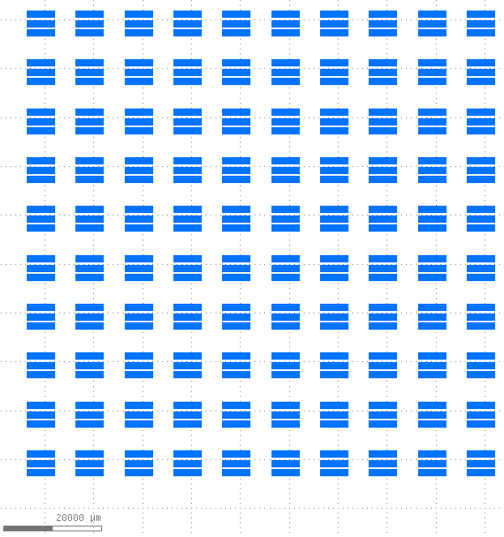
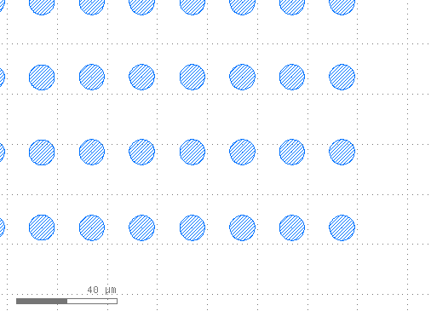
Identify a Feature that we can see on the microscope, that we can align rotation with
Replace these images with your own
Features that are meant to be horizontally aligned:
Align Rotation to These Edges

Slide 6
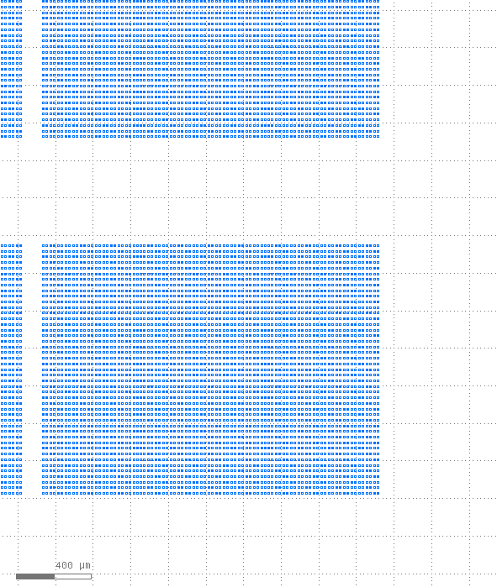
Identify a visible feature to which we can align the 2 cut angles, and offset from that feature
Replace these images with your own
Show a feature at the Edge of your die, and the offset from that feature
We align this at only one point, one for each cut-angle, called “Cut Position”
Cut Angle #1
Cut Angle #1
2200µm, from right edge of circle
Zoom-in of this region:
2400µm, from bottom edge of circle
Cut Angle #2
Cut Angle #2

Slide 7
Distance between cuts and number of cuts
Replace these images with your own
Using the previous “Cut Position”, the program will just step a certain distance and re-cut, a specified number of times.
In the program, this is called
“Step Index”: Distance between cuts
“Cut No.”: Number of cuts
These may be different for each Cut Angle
Cut Angle #1: 9 Cuts
Step index = 10mm
Cut Angle #2:
9 cuts
Step Index = 10mm

Slide 8
Blade Alignment Position: Sacrificial area of the wafer
Replace these images with your own
If possible, please provide an area ~3mm away from the edge of your wafer, and ~3mm away from your devices, on which to perform a test-cut to align the blade to the microscope crosshair.
If your sample is small/has no sacrificial area like this, we can align to a test-cut done on the dicing tape instead. Cutting the sample is better since it also “dresses” the blade.
Test-Cut area here, within 10mm from top of wafer.
which leaves >4mm away from top of devices

