Slide 1
ASML DUV Stepper
Programming Worksheet
2022-11-08
Items in YELLOW must be filled in with your own values

Slide 2
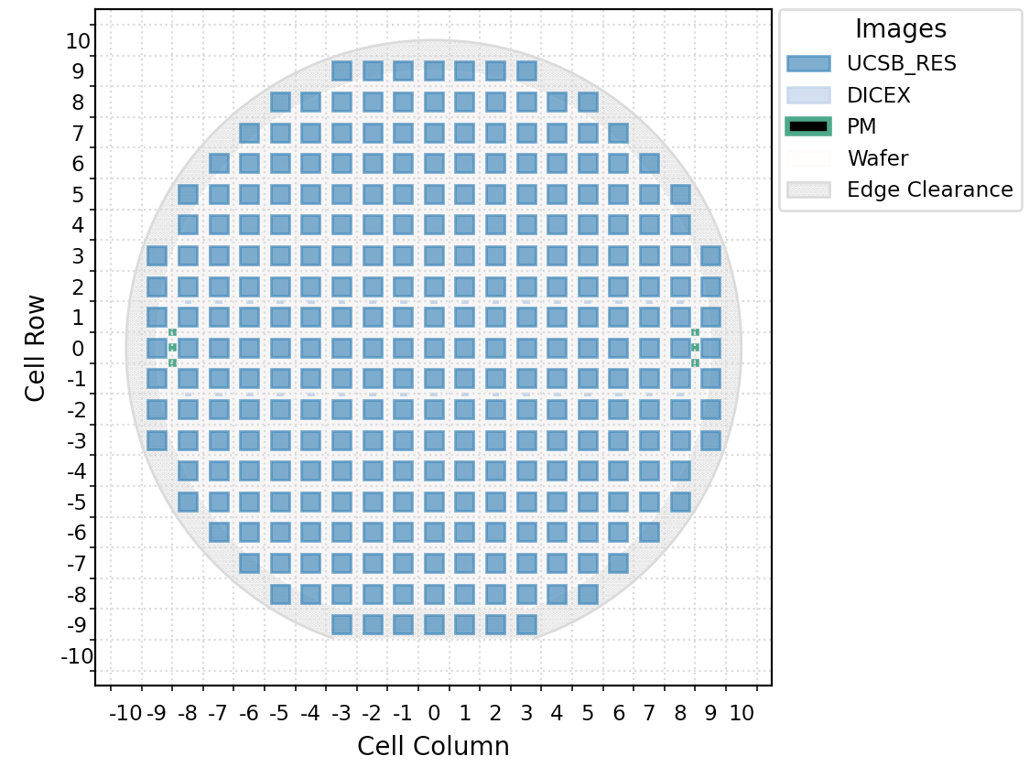
Wafer Layout
Cell Size: (X, Y) in mm
This should include any dicing lanes/spacing between die.
Cell Shift: By default, Die # (0,0) is centered at (0,0)
If you need to shift the entire Die matrix use Die Shift for this. Eg. a typical value might be ½ of the Die Size, so die corner falls on wafer center.
(0, 0) mm – max is ½ of Die Size
← Example: 5mm die, shift=0,0 mm
Note the ASML’s coordinate system,
Col 0, Row 0 – is at center of the wafer.
(You can generate a schematic in Klayout)

Slide 3
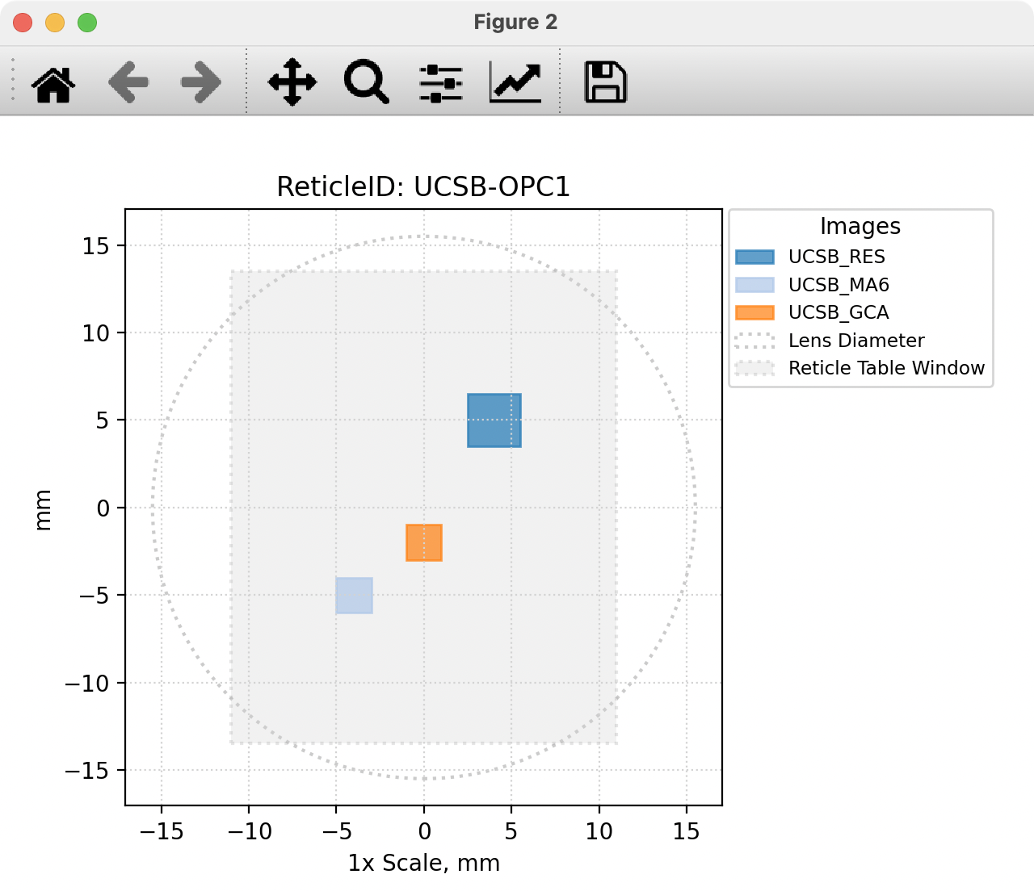
Mask Definition: Instructions
Which Parts of the Mask do you need exposed.
“Images” refer to individual pattern regions on the mask.
Example of 3 separate “Images” on the mask plate
Each Image needs (at 1x wafer-scale):
Image Center Coords
w/r/to center of mask plate
Image Size
Name for this image (<10char., arbitrary)
Image Name: “BOX3MM”
Image Size: (3,3mm)
Image Center:
X
(4,5)mm
SEPARATE Slide for Each Mask Plate

Slide 4
Mask Definition
Please only include Images required for this specific exposure job.
Don’t include other images on mask that will not be used at this time.
Reticle Barcode: “UCSBJAN2020”
Image/Layer ID | Image Size (wafer, mm) |  |  | Image Shift (wafer, mm)
 | X | Y |  | CenterX | CenterY
* Choose a short (<10char) name for each Image on your photomask, and enter the Size & Center coords for each Image. Add/delete rows as needed.
ImageName1 | 6.000000 | 3.900000 |  | -4.500000 | 0.000000
ImageName2 | 6.000000 | 3.900000 |  | -4.500000 | -5.000000
ImageName3 | 6.000000 | 3.900000 |  | -4.500000 | 5.000000
ImageName4 | 6.000000 | 3.900000 |  | 4.500000 | 5.000000
ImageName5 | 6.000000 | 3.900000 |  | 4.500000 | -5.000000
ImageName6 | 6.000000 | 3.900000 |  | 4.500000 | 0.000000
Make a SEPARATE Slide for Each Mask Plate

Slide 5
Alignment Definition
Specify exact coordinates of alignment marks to be placed by the stepper, and type of Alignment mark.
Type of Mark (If an Image from previous slide, specify Image Name). System marks are: “PM” (std), “SPM-X”, “SPM-Y”
These are all available on a system mask plate.
Alignment Mark Locations: |  | (If Needed)
Mark Type | X | Y
PM | -38.5 | 10
PM | -38.5 | 0
PM | -38.5 | -10
PM | 38.5 | 10
PM | 38.5 | 10
PM | 38.5 | -10

Slide 6
Wafer Layout: Instructions
For each Image to be placed on the wafer, I need:
• Image name and which Die to fill.
• Acceptable to say “all”, or “all except: Row -1, Col 0” etc.
Note the ASML’s coordinate system,
Col 0, Row – is at center of the wafer.

Slide 7
Wafer Layout
Image “BOX3MM”:
Only Top half of wafer: Row 1 and UP to edge
Image “BOX4MM”
Only BOTTOM half of wafer: Row 0 and DOWN to edge
No images in Die: Row -5, Col 0 (Alignment marks)
No Images in Die: Row +5, Col 0 (alignment marks)
CAD screenshot is welcome here to clarify any uncertainties

