Slide 1
Second layer on sample with BL/BR orientation using a 4 Layer mask
Inspect the sample with either BL/BR orientation (make sure the first layer is there along with the alignment mark needed for a second lithography).
Load the sample on a wafer chuck (be consistent and repeatable with simple tasks as loading sample on chuck, turning vacuum on, loading chuck on stage, turning vacuum on).
Make sure sample is vacuumed to the chuck (not moving), and a wafer chuck is vacuumed to the stage (not moving).
Load the program for second lithography
Aligning step (for sample with BL orientation use the key “A” to start aligning; for sample with BR orientation do not use key “A” to start aligning)
You are ready for the alignment step.

Slide 2
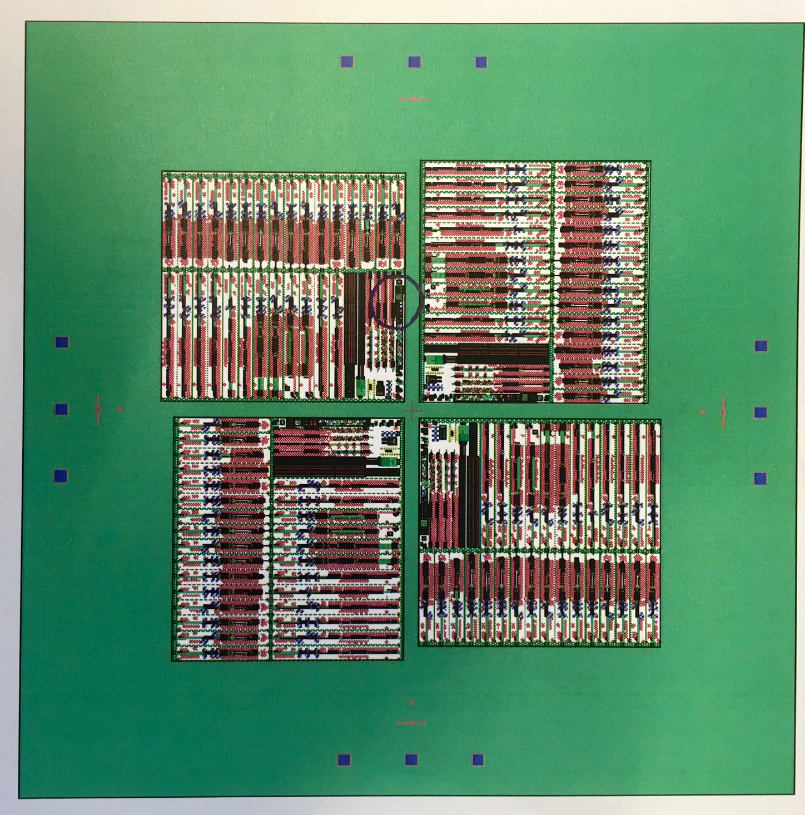
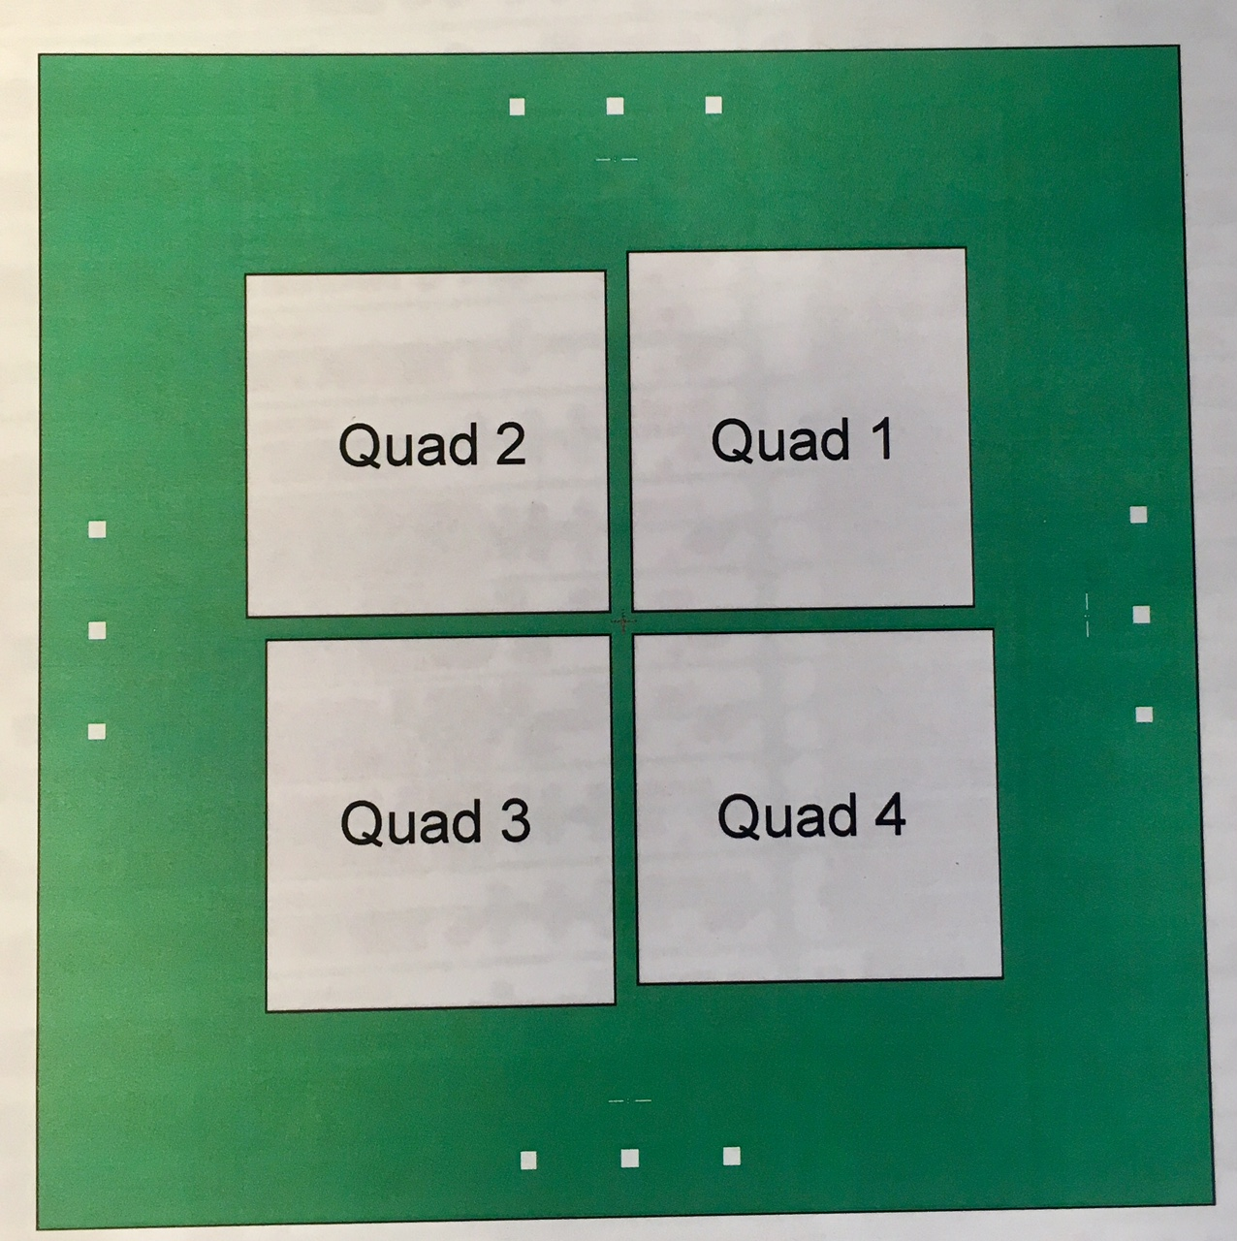
Second layer- for 4 Layer Mask Plate
Quad 1:
Key offset : X=+0.7875, Y=-3.8250
Pass Shift: X= +4.500, y=-4.500
The key offset and pas shift for all 4 Quadrants are going to be the same, if mask gets rotated for 90 degree for each layer that is going to be exposed (picture bellow).
If in every other lithography you want to use a new alignment mark, you need to find exact position of that alignment mark relative to the center of that die, and enter this info into program being used for exposure.
Pass shift is a distance from the center of the mask to the center of layer being exposed. Follow sign convention for the sign.
If the mask is not going to be rotated, the sign for pass shift is going to be different for each quadrant.
Quad 1: pass shift X= +4500, Y= - 4500
Quad 2: pass shift X= - 4500, Y= - 4500
Quad 3: pass shift X= -4500, Y= + 4500
Quad 4: pass shift X= + 4500, Y= + 4500
Key offset is going to be the same for all f quadrants:
X=+0.7875, Y=-3.8250
Pass shift: X= + 4.5000 Y= - 4.5000

Slide 3
Sign convention
Key offset
Pass shift
+x, +y
-x, +y
-x, -y
+x, -y
+x, +y
-x, -y
-x, +y
+x, +y

