Slide 1
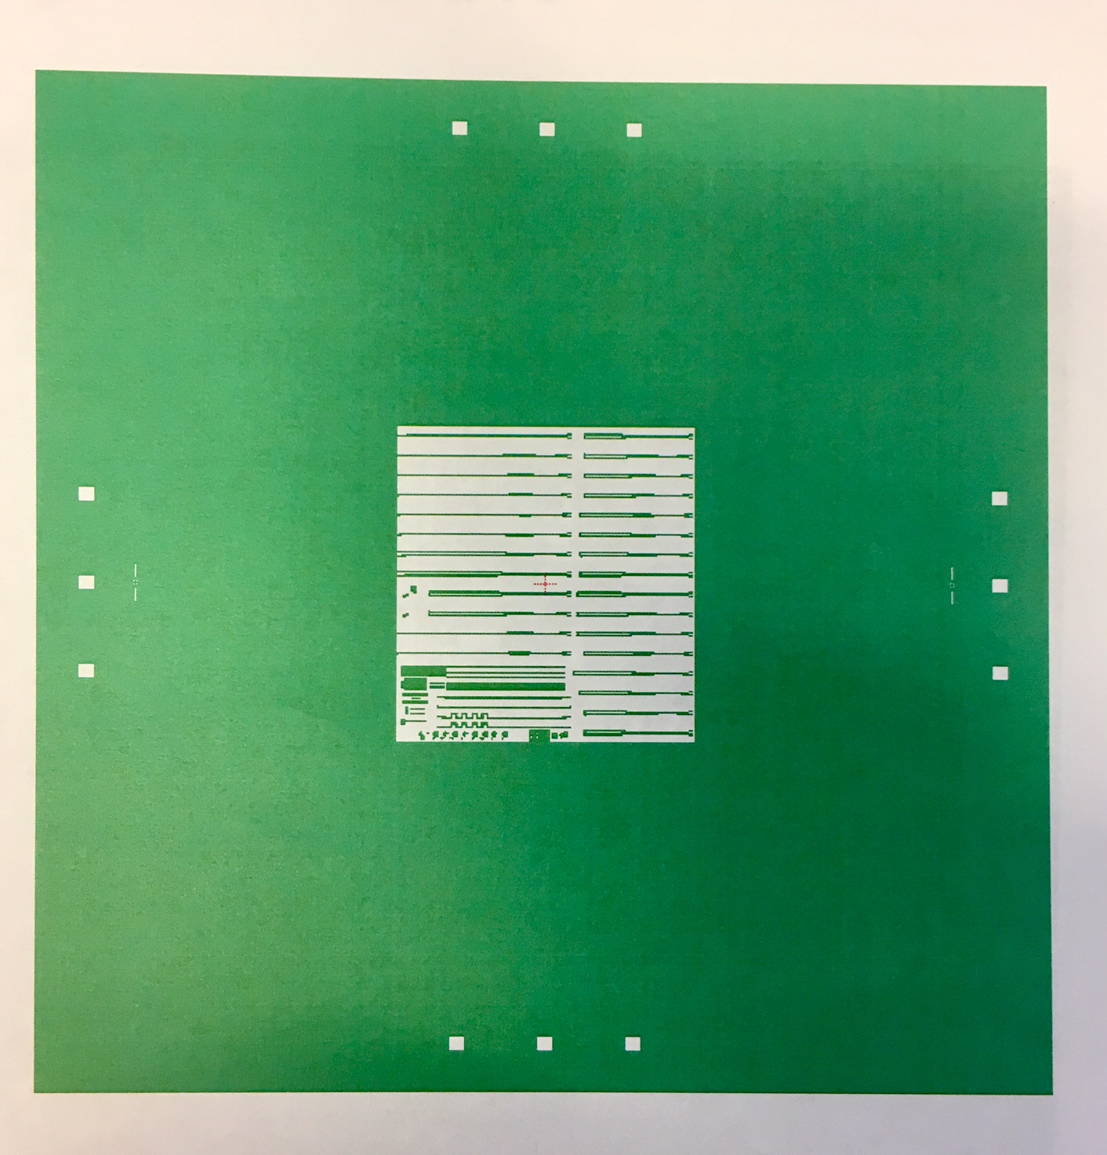
Mask Layouts
Single Layer Mask
( single field centered within the plate)

Slide 2
Mask Layouts
Single Layer Mask
( single field centered within the plate)

Slide 3
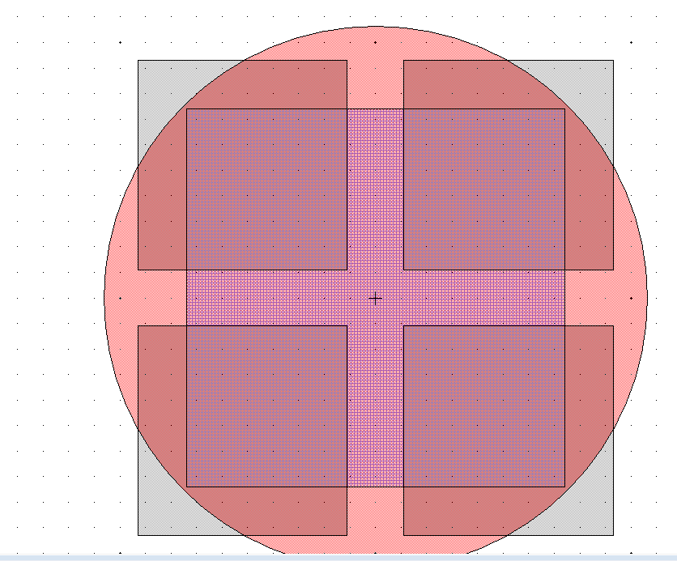
Exposure Field (red circle) D=100mm
Large Square (blue box),
max die size (74x74) mm2
This part of your mask will not be properly exposed
The blue box in the middle is the largest single square size (die size ~(14.8x14.8)mm2 that you can shoot on the wafer. This is because the “spot” size on the wafer is~20 mm, mask scale is 5x (100mm). Anything outside the red circle is not going to be exposed properly. There will be some bleed through but the features will be under expose.
Mask plate (5x5)” ~ (127x127)mm2

Slide 4
Quarter with BL orientation writing the program TESTQ
AUTOSTEP200: LOG IN [10,1]
CHUCK:142 (for ¼ of 2” pieces) or smaller then 2”)
Diameter= 55mm ( if 1/4 of 2 inch)
Cell size (die size): X=7.5750mm, Y=8.0000mm
Gap between die=0.5mm
Step size ( step from die to die):
X=8.0750mm, Y=8.5000mm
Distance from DIE center to the lower left corner:
X/2=3.7875mm
Y/2=4.0000mm
Adding 1 mm from the corner in X, and Y direction bring coordinates for x,y:
X=3.7875+1.0=4.7875mm
Y=4.0000+1.0=5.0000mm
This is the pass shift for BL orientation:
PASS SHIFT: x=+4.7875, y=-5.0000

Slide 5
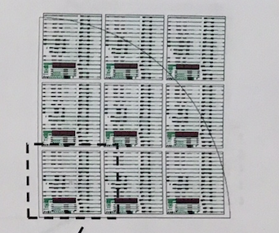
First layer (Active-Passive)
BL: L objective ( R3, C1), R objective ( R3, C3),
Press “A” on the key board (this makes stage to move), and left objective should be positioned above R3C1
Find the lower left corner, align horizontally and vertically
Key offset is : x=0, y=0
PASS SHIFT: x=+4.7875, y=-5.0000
C1
R1
R3C3
R3C1

Slide 6
How to pattern first layer (aligning to the corner of sample)
How to align
Orientation A - BL
Find the proper chuck, load the sample on the chuck, use screws to help in positioning the sample always at the same place ( vacuum ON)
Load chuck on the stage ( vacuum ON)
Press “A” on the key board to move the stage , so LEFT objective is above die R3C1
Find the BL corner
Press button “D” on the key board, and press on arrow ➔ to step from die to die. Be careful, step as many times as the number of dies you have in one direction. Be slow and meticulous. Stay on the sample.
If you step out of sample you might receive the message “ Q” for quit. Press “red” button inside of the chamber and start all over with the aligning
Record x, y (translate origin). Edit program later and change your translate origin from (0,0) to the new numbers. This would help to quickly find the corner if consistent in positioning of sample.
Once when aligning is complete ( use right window for aligning), make sure to go back to die R3C1 ,and your LEFT objective is above die R3C1, press expose
Watch the numbers on voltmeter (column height). This should be in range of -10V to 10V. Ideal focus would be around 0V.
If 0.5mm is added along the edges (x,y).
I prefer to added 1mm !

Slide 7
Quarter with BR orientation writing the program TESTQ
AUTOSTEP200: LOG IN [10,1]
CHUCK:142 (for ¼ of 2” pieces) or smaller then 2”)
Diameter= 55mm ( if 1/4 of 2 inch)
Cell size (die size):
X=7.5750mm, Y=8.0000mm
Gap between die=0.5mm
Step size ( step from die to die):
X=8.0750mm, Y=8.5000mm
Distance from DIE center to the lower left corner:
X/2=3.7875mm
Y/2=4.0000mm
Adding 1 mm from the corner in X, and Y direction bring coordinates for x,y:
X=3.7875+1.0=4.7875mm
Y=4.0000+1.0=5.0000mm
This is the pass shift for BL orientation:
PASS SHIFT: x=-4.7875, y=-5.0000

Slide 8
First layer (Active-Passive)
BR orientation: L objective (R3,C1), R objective (R3,C3),
Find the lower right corner, align horizontally and vertically
The right objective should be positioned above R3C3 prior exposing
Key offset is : x=0, y=0
PASS SHIFT: x=-4.7875, y=-5.0000
C1
R1
R3C3
R3C1

Slide 9
How to pattern first layer (aligning to the corner of sample)
How to align
Orientation B - BR
Find the proper chuck, load the sample on the chuck, use screws to help in positioning the sample always at the same place ( vacuum ON)
Load chuck on the stage ( vacuum ON)
Find the BR corner
Press button “D” on the key board, and press on arrow ➔ to step from die to die. Be careful, step as many times as the number of dies you have in one direction. Be slow and meticulous. Stay on the sample.
If you step out of the sample you might receive the message “Q” and option to quit. Press “red” button inside of the chamber (lower, left side) and you have to start all over with aligning
Record x, y (translate origin). Edit program later and change your translate origin from (0,0) to the new numbers. This would help to quickly find the corner if consistent in positioning of sample.
Once when aligned, make sure your RIGHT objective is above die R3C3, press expose
Watch the numbers on voltmeter (column height). This should be in range of -10V to 10V. Ideal focus would be around 0V.
If 0.5mm is added along the edges (x,y).
I prefer to added 1mm !

Slide 10
Second layer- for single centered mask
Aligning to BL orientation
Find first alignment mark( global) in R3C1
Align as you would normally align BL orientation
Key offset : X=+0.7875, Y=-3.8250
Pass shift: X=0, Y=0
Aligning to BR orientation
Find first alignment mark( global) in R3C3
Align as you would normally align BR orientation
Key offset : X=+0.7875, Y=-3.8250
Pass shift: X=0, Y=0

Slide 11
Second layer- for 4 Layer mask
Key offset for all 4 Quads is same (picture bellow):
X=+0.7875, Y=-3.8250 (in mm)
Only if the same alignment mark is used for aligning all 4 quads.
If not, read position of alignment mark that you are going to use for aligning. Use the key offset sign convention to figure out the sign for alignment mark.
Key offset is distance from the center of layer to the center of the alignment mark
Quad1: pass shift X= +, Y= -
Quad2: pass shift X= -, Y= -
Quad3: pass shift X= -, Y= +
Quad4: pass shift X= +, Y= +
Pass shift is distance from center of the layer to the center of the mask, in mm at the wafer level

Slide 12
Sign convention
Key offset
Pass shift
+x, +y
+x, +y

